Slide 1
WEEK 4: DATA VISUALIZATION & DASHBOARDING
Two Interactive Power BI Dashboards — Global Health Data & Retail Sales Performance
Ikeoluwa Ajayi
Data Analytics Internship | AnalystLab Africa

Slide 2
What This Week Covered
🦠
Global COVID-19 Impact Dashboard
🛒
Superstore Sales Performance Dashboard
Confirmed cases, deaths, and recovery trends across 190+ countries, Jan 2020 – Mar 2023
Cleaned and reshaped raw wide-format time series data into an analysis-ready long format
Built 5 KPIs and 6 visuals with country, date, and drill-down interactivity
Revenue, profit, and regional performance across ~10,000 retail orders, 2014–2017
Defined 6 core KPIs including profit margin and category-level profitability
Built 7 visuals with region, category, and date-range slicers plus drill-down

Slide 3
COVID-19 Dashboard · Dataset Overview
Source
3
190+
3+ yrs
CSSEGISandData/COVID-19 (Johns Hopkins CSSE) — official GitHub repository, three global time-series files: confirmed, deaths, and recovered cases.
Source Files
Merged
Countries &
Territories
Of Daily
Tracking
Structure Challenge
Data arrived in wide format — one column per date. Unpivoted each file into long format (one row per country per date), then merged all three into a single model.
Key Data Limitation
Global recovery-case tracking was discontinued far earlier than confirmed-case and death tracking. Recovery Rate reflects the last date recovery data was available — not the same end date as Confirmed/Deaths — so it understates true recovery.
Timeframe & Scope
January 22, 2020 – March 9, 2023, covering 190+ countries and territories. Data is cumulative, not daily — each value is a running total.

Slide 4
COVID-19 Dashboard · Business Problem & KPIs
Business Question:
Which countries were hit hardest, how has the death rate evolved, and how reliable is the recovery picture?
677M
7M
136M
20.06%
1.02%
Total Confirmed
Total Deaths
Total Recovered
Recovery Rate
Death Rate
Additional visuals built:
Cases by Country — top 10 countries by confirmed cases
Recovery vs. Death comparison by country
Daily New Confirmed — new cases per day, revealing pandemic waves
Death Rate Trend — % of confirmed cases resulting in death, over time
Global Case Trend — cumulative confirmed cases climbing over time
Geographic bubble map — global concentration of confirmed cases

Slide 5
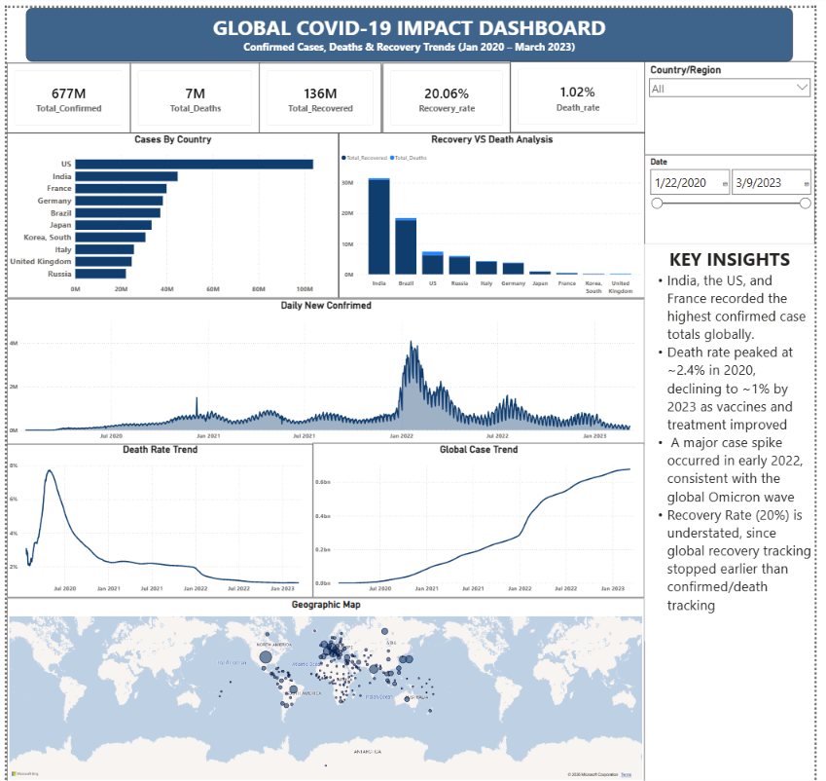
COVID-19 Dashboard · Final View

Slide 6
COVID-19 Dashboard · Key Insights
🌍
Case concentration
📉
Death rate improved sharply
India, the US, and France recorded the highest confirmed case totals globally — a small group of countries account for a disproportionate share of the global case count.
Death rate peaked around 2.2% in 2020 and declined to roughly 1% by 2022, reflecting expanded testing, improved treatment, and vaccine rollout.
📈
Omicron drove the largest spike
⚠️
Recovery Rate is an underestimate
The single largest wave of daily new confirmed cases occurred in early 2022, consistent with the global Omicron variant surge.
Because global recovery tracking stopped earlier than confirmed/death tracking, the 20% Recovery Rate reflects a much earlier snapshot — actual recovery is almost certainly far higher.

Slide 7
Superstore Dashboard · Dataset Overview
Source
5K
793
3
Sample Superstore dataset (Kaggle) — order-level retail transactions across the United States.
Total Orders
Customers
Categories
Structure
Already in long/tidy format — one row per order line item. Main preparation: fixing character encoding (Latin-1) and converting Order Date / Ship Date using a US locale.
Key Modeling Note
The Sales column is already a pre-calculated total per line item (quantity × unit price), not a per-unit price — confirmed by checking Sales ÷ Quantity against realistic per-item prices before building Total Revenue.
Timeframe & Scope
January 2014 – December 2017. Covers Consumer, Corporate, and Home Office segments across Technology, Furniture, and Office Supplies categories.

Slide 8
Superstore Dashboard · Business Problem & KPIs
Business Question:
Which regions and categories drive profit — not just revenue — and where is the business underperforming?
$2.30M
$286.4K
5K
12.47%
Total Revenue
Total Profit
Total Orders
Profit Margin
Additional visuals built:
Top Performing Region — revenue by region (West leads)
Best Selling Category — revenue by product category
Sales by Segment — donut chart, Consumer vs. Corporate vs. Home Office
Profit by Category — spotlighting Furniture's weak profit performance
Sales Trend & Profit Over Time — line charts, 2014–2017
Sales by Region — geographic map of order locations
Region, Category & Order Date slicers, with Region → State and Category → Sub-Category drill-down

Slide 9
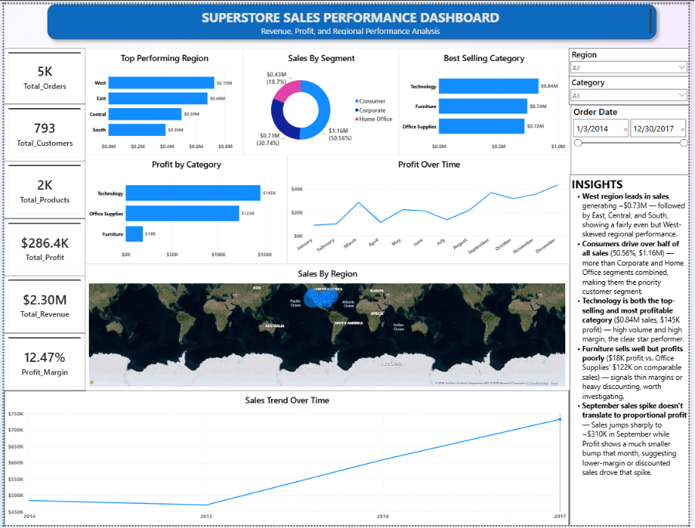
Superstore Dashboard · Final View

Slide 10
Superstore Dashboard · Key Insights
🏆
West region leads sales
👥
Consumers drive over half of sales
The West region generates ~$0.73M in sales, ahead of East, Central, and South — a fairly even but West-skewed regional performance.
The Consumer segment accounts for $1.16M (50.6%) — more than Corporate and Home Office combined, making it the priority customer segment.
⭐
Technology is the standout performer
🪑
Furniture sells well but profits poorly
Technology leads in both sales ($0.84M) and profit ($145K) — high volume paired with high margin makes it the clear star category.
Furniture earns just $18K profit vs. Office Supplies' $122K on comparable sales — a sign of thin margins or heavy discounting worth investigating.

Slide 11
Challenges Faced
Wide-to-long reshaping
Cumulative data ≠ simple SUM
Multi-column merge failures
COVID's date-per-column format had to be unpivoted into one row per country per date before any modeling was possible.
Summing daily cumulative totals wildly overstated case counts. Fixed using each country's own last-reporting-date total instead.
Merging confirmed, deaths, and recovered tables initially returned all nulls — caused by matching columns in a different click-order across the two tables.
Encoding errors on import
Locale-driven date errors
Date-context-dependent DAX
Special characters in the Superstore CSV caused import failures until the encoding was switched from UTF-8 to Latin-1 (ISO-8859-1).
Both COVID and Superstore dates parsed incorrectly (day/month swapped) until explicitly set to a US (Month/Day/Year) locale.
Growth-rate style measures using DATEADD only calculate correctly inside a chart with Date on an axis — they return misleading flat values on a standalone KPI card.

Slide 12
Conclusion & Recommendations
What this week demonstrated
Recommendations
End-to-end BI workflow: raw source data → cleaned model → KPIs → interactive dashboard
Handling real-world data quality issues (encoding, locale, cumulative vs. daily values)
Applying interactivity (slicers, drill-down) and storytelling (in-dashboard insights) so the data speaks directly to a non-technical viewer
COVID-19: Treat Recovery Rate as a lower bound, not a precise figure, given discontinued recovery tracking
Superstore: Investigate discounting/cost structure behind Furniture's weak profit margin relative to its sales volume
Both: Prioritize the West region and Technology category for continued investment; monitor Furniture for margin improvement
Thank you — AnalystLab Africa Data Analytics Internship

